Slide 1

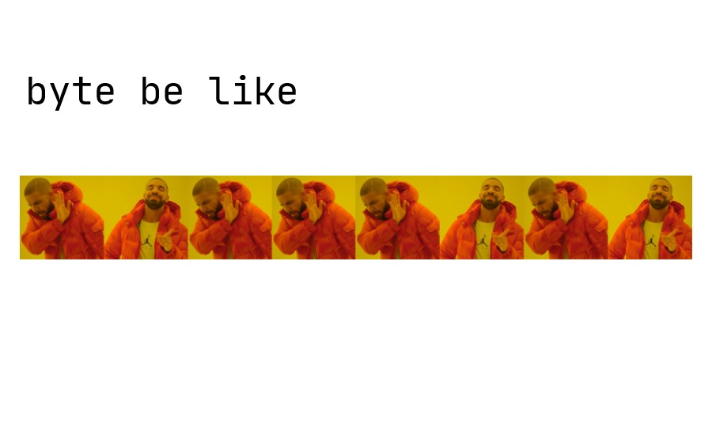
EECS 370 - Lecture 5
ARM to Assembly
Live Poll + Q&A: slido.com #eecs370
Poll and Q&A Link

Slide 2
Important Data

Slide 3
Announcements
HW 2
Posted on website, due Sunday night
P1
3 parts, first part due Wednesday
See walkthrough on website!
Get exam conflicts and SSD accommodations sent to us by Friday
Forms listed on the website

Slide 4
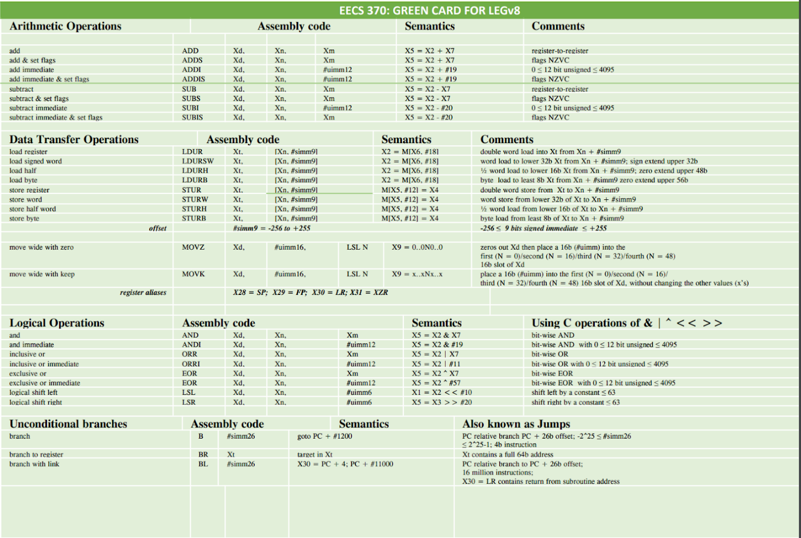
Resources
Many resources on 370 website
https://eecs370.github.io/#resources
ARMv8 references
Async discussion recordings

Slide 5
Instruction Set Architecture (ISA) Design Lectures
Lecture 2: ISA - storage types, binary and addressing modes
Lecture 3 : LC2K
Lecture 4 : ARM
Lecture 5 : Converting C to assembly – basic blocks
Lecture 6 : Converting C to assembly – functions
Lecture 7 : Translation software; libraries, memory layout
Notes:
Known for
Dynabook object-oriented programming Smalltalk

Slide 6

Load Instruction Sizes
le durb
How much data is retrieved from memory at the given address?
Desired amount of data
Operation
Unused bits in
Example
to transfer?
register?
64
-
bits (double word or
LDUR (Load
N/A
0x
FEDC_BA98_7654_3210
whole register)
unscaled to
register)
16
-
bits (half
-
word) into
LDURH
Set to zero
0x0000_0000_0000_
3210
lower bits of reg
8
-
bits (byte) into lower
LDURB
Set to zero
0x0000_0000_0000_00
10
bits of reg
32
-
bits (word) into
LDURSW (load
Sign extend (0 or 1
0x0000_0000
_
7
654_3210
lower bits of reg
signed
word)
based on most
or
significant bit of
0xFFFF_FFFF
_
F
654_3210
transferred word)
(depends on bit 31)

Slide 7
Load Instruction in Action
TODO: add other instructions?
ARM ISA
struct {
int arr[25];
unsigned char c;
} my_struct;
int func() {
my_struct.c++;
// load value from mem into reg
// then increment it
}
LDURB X3, [X4, #100]
10
2600
X3
10
Calculate address:
X4
2500
2500 + 100 = 2600

Slide 8
Load Instruction in Action – other example
ARM ISA
int my_big_number = -534159618; // 0xE0295EFE in 2's complement
int inc_number() {
my_big_number++;
// load value from mem into reg
// then increment it
};
LDURSW X3, [X4, #0]
Sign extend (0xE0295EFE) to
64 bits → 0x FFFFFFFFE0295EFE
FE
2604
X3
FFFF…5EFE
Calculate address:
5E
2605
X4
2604
2604 + 0 = 2604
29
2606
E0
2607
Need to sign extend, otherwise final register value will be positive!!!

Slide 9
But wait…
int my_big_number = -534159618; // 0xE0295EFE in 2's complement
If I want to store this number in memory… should it be stored like this?
… or like this?
FE
2604
5E
2605
29
2606
E0
2607
E0
2604
29
2605
58
2606
FE
2607

Slide 10
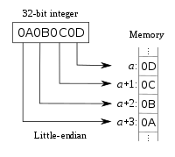
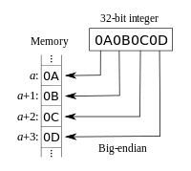
Big Endian vs. Little Endian
Poll: Which do you prefer?
Big Endian
Little Endian
Endian-ness: ordering of bytes within a word
Little – Bigger address holds more significant bits
Big – Opposite, smaller address hold more significant bits
The Internet is big endian, x86 is little endian, LEG and ARMv8 can switch
But in general assume little endian. (Figures from Wikipedia)
Live Poll + Q&A: slido.com #eecs370

Slide 11
Store Instructions
ARM ISA
Store instructions are simpler—there is no sign/zero extension to consider (do you see why?)
Desired amount of data
Operation
Example
to transfer?
64
-
bits (double word or
STUR (Store
0x
FEDC_BA98_7654_3210
whole register)
unscaled
register)
16
-
bits (half
-
word) from
STURH
0x0000_0000_0000_
3210
lower bits of reg
8
-
bits (byte) from lower
STURB
0x0000_0000_0000_00
10
bits of reg
32
-
bits (word) from
STURW
0xFFFF_FFFF
_
F
654_3210
lower bits of reg

Slide 12
Example Code Sequence
ARM ISA
What is the final state of memory once you execute the following instruction sequence? (assume X5 has the value of 0)
little endian
LDUR X4, [X5, #100]
LDURB X3, [X5, #102]
STUR X3, [X5, #100]
STURB X4, [X5, #102]
0x02
100
register file
0x03
101
X3
0xFF
102
0x05
103
X4
0xC2
104
Poll: Final contents of registers?
0x11..FF : 0xE5..02
0x00..FF : 0x02..E5
0x11..FF : 0x02..E5
0x00..FF : 0xE5..02
0x06
105
0xFF
106
Memory (each location is 1 byte)
0xE5
107
Live Poll + Q&A: slido.com #eecs370
Notes:
Lc2K – bendian doesn’t matter because each location is a word
little endian / big endian
little endian: intel, arm
big-endian: motorola, old sun/java, networks, powerPc
bi-endian: mips
gulliver

Slide 13
Example Code Sequence
ARM ISA
What is the final state of memory once you execute the following instruction sequence? (assume X5 has the value of 0)
little endian
LDUR X4, [X5, #100]
LDURB X3, [X5, #102]
STUR X3, [X5, #100]
STURB X4, [X5, #102]
0x02
100
register file
0x03
101
X3
0xFF
102
0x05
103
X4
0xE5FF06C205FF0302
0xC2
104
0x06
105
0xFF
106
Memory (each location is 1 byte)
0xE5
107
Notes:
Lc2K – bendian doesn’t matter because each location is a word
little endian / big endian
little endian: intel, arm
big-endian: motorola, old sun/java, networks, powerPc
bi-endian: mips
gulliver

Slide 14
Example Code Sequence
ARM ISA
What is the final state of memory once you execute the following instruction sequence? (assume X5 has the value of 0)
little endian
LDUR X4, [X5, #100]
LDURB X3, [X5, #102]
STUR X3, [X5, #100]
STURB X4, [X5, #102]
0x02
100
register file
0x03
101
X3
0x00000000000000FF
0xFF
102
0x05
103
X4
0xE5FF06C205FF0302
0xC2
104
0x06
105
0xFF
106
Memory (each location is 1 byte)
0xE5
107
Notes:
Lc2K – bendian doesn’t matter because each location is a word
little endian / big endian
little endian: intel, arm
big-endian: motorola, old sun/java, networks, powerPc
bi-endian: mips
gulliver

Slide 15
Example Code Sequence
ARM ISA
What is the final state of memory once you execute the following instruction sequence? (assume X5 has the value of 0)
little endian
LDUR X4, [X5, #100]
LDURB X3, [X5, #102]
STUR X3, [X5, #100]
STURB X4, [X5, #102]
0xFF
100
register file
0x00
101
X3
0x00000000000000FF
0x00
102
0x00
103
X4
0xE5FF06C205FF0302
0x00
104
0x00
105
0x00
106
Memory (each location is 1 byte)
0x00
107
Notes:
Lc2K – bendian doesn’t matter because each location is a word
little endian / big endian
little endian: intel, arm
big-endian: motorola, old sun/java, networks, powerPc
bi-endian: mips
gulliver

Slide 16
Example Code Sequence
ARM ISA
What is the final state of memory once you execute the following instruction sequence? (assume X5 has the value of 0)
little endian
LDUR X4, [X5, #100]
LDURB X3, [X5, #102]
STUR X3, [X5, #100]
STURB X4, [X5, #102]
0xFF
100
register file
0x00
101
X3
0x00000000000000FF
0x02
102
0x00
103
X4
0xE5FF06C205FF0302
0x00
104
0x00
105
0x00
106
Memory (each location is 1 byte)
0x00
107
Notes:
Lc2K – bendian doesn’t matter because each location is a word
little endian / big endian
little endian: intel, arm
big-endian: motorola, old sun/java, networks, powerPc
bi-endian: mips
gulliver

Slide 17
Example Code Sequence (2)
ARM ISA
What is the final state of memory once you execute the following instruction sequence? (assume X5 has the value of 0)
little endian
LDUR X4, [X5, #100]
LDURB X3, [X5, #102]
STURB X3, [X5, #103]
LDURSW X4, [X5, #100]
0x02
100
register file
0x03
101
X3
0xFF
102
0x05
103
X4
0xC2
104
We shown the registers as blank. What do they actually contain before we run the snippet of code?
0x06
105
0xFF
106
Memory (each location is 1 byte)
0xE5
107

Slide 18
Example Code Sequence (2)
ARM ISA
What is the final state of memory once you execute the following instruction sequence? (assume X5 has the value of 0)
little endian
LDUR X4, [X5, #100]
LDURB X3, [X5, #102]
STURB X3, [X5, #103]
LDURSW X4, [X5, #100]
0x02
100
register file
0x03
101
X3
0xFF
102
0x05
103
X4
0xE5FF06C205FF0302
0xC2
104
0x06
105
0xFF
106
Memory (each location is 1 byte)
0xE5
107

Slide 19
Example Code Sequence (2)
ARM ISA
What is the final state of memory once you execute the following instruction sequence? (assume X5 has the value of 0)
little endian
LDUR X4, [X5, #100]
LDURB X3, [X5, #102]
STURB X3, [X5, #103]
LDURSW X4, [X5, #100]
0x02
100
register file
0x03
101
X3
0x00000000000000FF
0xFF
102
0x05
103
X4
0xE5FF06C205FF0302
0xC2
104
0x06
105
0xFF
106
Memory (each location is 1 byte)
0xE5
107

Slide 20
Example Code Sequence (2)
ARM ISA
What is the final state of memory once you execute the following instruction sequence? (assume X5 has the value of 0)
little endian
LDUR X4, [X5, #100]
LDURB X3, [X5, #102]
STURB X3, [X5, #103]
LDURSW X4, [X5, #100]
0x02
100
register file
0x03
101
X3
0x00000000000000FF
0xFF
102
0xFF
103
X4
0xE5FF06C205FF0302
0xC2
104
0x06
105
0xFF
106
Memory (each location is 1 byte)
0xE5
107

Slide 21
Example Code Sequence (2)
ARM ISA
What is the final state of memory once you execute the following instruction sequence? (assume X5 has the value of 0)
little endian
LDUR X4, [X5, #100]
LDURB X3, [X5, #102]
STURB X3, [X5, #103]
LDURSW X4, [X5, #100]
0x02
100
register file
0x03
101
X3
0x00000000000000FF
0xFF
102
0xFF
103
X4
0xFFFFFFFFFFFF0302
0xC2
104
0x06
105
0xFF
106
Memory (each location is 1 byte)
0xE5
107

Slide 22
Converting C to assembly – example 2
Write ARM assembly code for the following C expression:
(assume an int is 4 bytes and that struct elements are stored contiguously)
struct { int a; unsigned char b, c; } y;
y.a = y.b + y.c;
Assume that a pointer to y is in X1.
Notes:
Even if b and c were just char the top of X2 would be zeroed
Assuming int is 32 bits and char is 8 bits

Slide 23
Converting C to assembly – example 2
Write ARM assembly code for the following C expression:
(assume an int is 4 bytes and that struct elements are stored contiguously)
struct { int a; unsigned char b, c; } y;
y.a = y.b + y.c;
Assume that a pointer to y is in X1.
LDURB X2, [X1, #4] // load y.b
LDURB X3, [X1, #5] // load y.c
ADD X4, X2, X3 // calculate y.b+y.c
STURW X4, [X1, #0] // store y.a
Notes:
Even if b and c were just char the top of X2 would be zeroed
Assuming int is 32 bits and char is 8 bits

Slide 24
Calculating Load/Store Addresses for Variables
Datatype | size (bytes)
short | 2
char | 1
int | 4
double | 8
short a[100];
char b;
int c;
double d;
short e;
struct {
char f;
int g[1];
char h;
} i;
Problem: Assume data memory starts at address 100, calculate the total amount of memory needed
a = 2 bytes * 100 = 200
b = 1 byte
c = 4 bytes
d = 8 bytes
e = 2 bytes
i = 1 + 4 + 1 = 6 bytes
total = 221, right or wrong?
Notes:
L2 stopped here
why alignment ?
because they want to make sure that they don't need to read two memory rows for a load operation
typically 16-32 bytes (always power of 2)
intel lets you break this rule, but it converts an unaligned load in two loads, takes more time
hence compilers still try to avoid this.

Slide 25
Memory layout of variables
Compilers don't like variables placed in memory arbitrarily
As we'll see later in the course, memory is divided into fixed sized chunks
When we load from a particular chunk, we really read the whole chunk
Usually an integer number of words (32 bits)
If we read a single char (1 byte), it doesn't matter where it's placed
ldurb [x0, 0x1002]
Reads [0x1000-0x1003], then throws away all but 0x1002, fine
0x1000 | 0x1001 | 0x1002 | 0x1003
'a' | 'b' | 'c' | 'd'

Slide 26
Memory layout of variables
BUT, if we read a 32-bit integer word, and that word starts at 0x1002:
First we need to read [0x1000-0x1003], throw away 0x1000 and 0x1001, then read [0x1004-0x1007]
Need to read from memory twice! Slow! Complicated! Bad!
0x1000 | 0x1001 | 0x1002 | 0x1003
0xFF | 0xFF | 0x12 | 0x34
0x1004 | 0x1005 | 0x1006 | 0x1007
0x56 | 0x78 | 0xFF | 0xFF

Slide 27
Solution: Memory Alignment
Poll: Where can chars start?
Most modern ISAs require that data be aligned
An N-byte variable must start at an address A, such that (A%N) == 0
For example, starting address of a 32 bit int must be divisible by 4
Starting address of a 16 bit short must be divisible by 2
int can start here
int CAN'T start here
0x1000 | 0x1001 | 0x1002 | 0x1003
0x12 | 0x34 | 0x56 | 0x78
short can start here
int CAN'T start here
0x1000 | 0x1001 | 0x1002 | 0x1003
0x12 | 0x34 | 0x56 | 0x78

Slide 28
Golden Rule of Alignment
Every (primitive) object starts at an address divisible by its size
"Padding" is placed in between objects if needed
But what about non-primitive data types?
Arrays? Treat as independent objects
Structs? Trickier…
char c;
short s;
int i;
0x1000 | 0x1001 | 0x1002 | 0x1003 | 0x1004 | 0x1005 | 0x1006 | 0x1007
[c] | [padding] | [s] |  | [i]
Notes:
L2 stopped here
why alignment ?
because they want to make sure that they don't need to read two memory rows for a load operation
typically 16-32 bytes (always power of 2)
intel lets you break this rule, but it converts an unaligned load in two loads, takes more time
hence compilers still try to avoid this.

Slide 29
Problem with Structs
char c;
struct {
char c;
int i;
} s[2];
If we align each element of a struct according to the Golden Rule, we can still run into issues
E.g.: An array of structs
Why is this bad?
It makes "for" loops very difficult to write!
Offsets need to be different on each iteration
Amount of padding is different across different instances
1000 | 1001 | 1002 | 1003 | 1004 | 1005 | 1006 | 1007 | 1008 | 1009 | 100A | 100B | 100C | 100D | 100E | 100F
c | s[0].c | [pad] | [pad] | s[0].i |  |  |  | s[1].c | [pad] | [pad] | [pad] | s[1].i

Slide 30
Structure Alignment
Solution: in addition to laying out each field according to Golden Rule…
Identify largest (primitive) field
Starting address of overall struct is aligned based on the largest field
Padded in the back so total size is a multiple of the largest primitive
char c;
struct {
char c;
int i;
} s[2];
1000 | 1001 | 1002 | 1003 | 1004 | 1005 | 1006 | 1007 | 1008 | 1009 | 100A | 100B | 100C | 100D | 100E | 100F
c | [pad] | [pad] | [pad] | s[0].c | [pad] | [pad] | [pad] | s[0].i |  |  |  | s[1.c] | [pad] | [pad] | [pad]
Guaranteed to lay out each instance identically

Slide 31
Structure Example
Poll: What boundary should this struct be aligned to?
1 byte
4 bytes
12 bytes
2 bytes
19 bytes
struct {
char w;
int x[3]
char y;
short z;
}
Assume struct starts at location 1000,
char w 🡪 1000
x[0] 🡪 1004-1007, x[1] 🡪 1008 – 1011, x[2] 🡪 1012 – 1015
char y 🡪 1016
short z 🡪 1018 – 1019 Total size = 20 bytes!

Slide 32
Calculating Load/Store Addresses for Variables
Datatype | size (bytes)
short | 2
char | 1
int | 4
double | 8
short a[100];
char b;
int c;
double d;
short e;
struct {
char f;
int g[1];
char h;
} i;
Problem: Assume data memory starts at address 100, calculate the total amount of memory needed
a = 200 bytes (100-299)
b = 1 byte (300-300)
c = 4 bytes (304-307)
d = 8 bytes (312-319)
e = 2 bytes (320-321)
struct: largest field is 4 bytes, start at 324
f = 1 byte (324-324)
g = 4 bytes (328-331)
h = 1 byte (332-332)
i = 12 bytes (324-335)
236 bytes total!! (compared to 221, originally)
Notes:
L2 stopped here
why alignment ?
because they want to make sure that they don't need to read two memory rows for a load operation
typically 16-32 bytes (always power of 2)
intel lets you break this rule, but it converts an unaligned load in two loads, takes more time
hence compilers still try to avoid this.

Slide 33
Class Problem
Work through exercise on your own
How much memory is required for the following data, assuming that the data starts at address 200 and is a 32 bit address space?
int a;
struct {double b, char c, int d} e;
char* f;
short g[20];
Poll: How much memory?
x < 40 bytes
40 < x < 50 bytes
50 < x < 60 bytes
60 < x bytes
Notes:
in modern compilers int and pts are usually the same number of bytes
a 🡪 200-203
struct 🡪 largest subfield is double, thus size/align is 8
204-207 white space
e.b 🡪 208-215
e.c 🡪 216-216
e.d 🡪 220-223
struct 🡪 size must be multiple of 8, total is 16 so no padding necessary
f 🡪 224-227 (remember char * is 4 bytes not 1!)
g 🡪 228-267
68 bytes

Slide 34
Data Layout – Why?
Does gcc (or another compiler) reorder variables in memory to avoid padding?
No, C99 forbids this
Memory is laid out in order of declaration for structs
The programmer (i.e., you) are expected to manage data layout of variables for your program and structs.
Two optimal strategies:
Order fields in struct by datatype size, smallest first
Or by largest first

Slide 35
ARM/LEGv8 Sequencing Instructions
Sequencing instructions change the flow of instructions that are executed
This is achieved by modifying the program counter (PC)
Unconditional branches are the most straightforward they ALWAYS change the PC and thus “jump” to another instruction out of the usual sequence
Conditional branches
If (condition_test) goto target_address
condition_test examines the four flags from the processor status word (SPSR)
target_address is a 19 bit signed word displacement on current PC

Slide 36
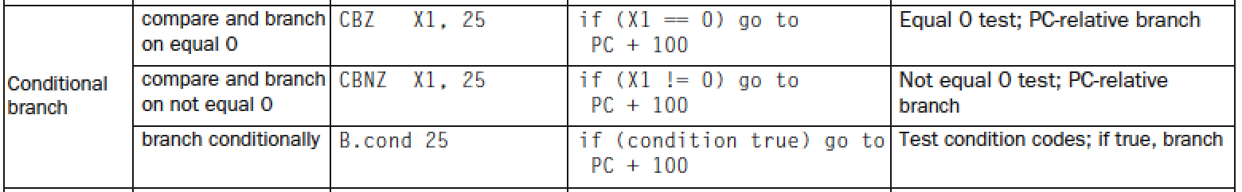
LEGv8 Conditional Instructions
Two varieties of conditional branches
One type compares a register to see if it is equal to zero.
Another type checks the condition codes set in the status register.
Let’s look at the first type: CBZ and CBNZ
CBZ: Conditional Branch if Zero
CBNZ: Conditional Branch if Not Zero

Slide 37
LEGv8 Conditional Instructions
CBZ/CBNZ: test a register against zero and branch to a PC relative address
The relative address is a 19 bit signed integer—the number of instructions. Recall instructions are 32 bits of 4 bytes
Example: CBNZ X3, Again
If X3 doesn’t equal 0, then branch to label “Again”
“Again” is an offset from the PC of the current instruction (CBNZ)
Why does “25” in the above table result in PC + 100?

Slide 38
LEGv8 Conditional Instructions
Example: What would the offset or displacement be if there were two instructions between ADDI and CBNZ?
Again: ADDI X3, X3, #-1
--------------
--------------
CBNZ X3, Again
Answer = -3
The offset field is 19 bits signed so the bit pattern would be 111 1111 1111 1111 1111 1101
Two 00’s are appended to the above 19 bits and then the result would be sign-extended (with one’s) to 64 bits and added to the value of PC at CBNZ
Why the two 00’s?
Poll: What's the offset?
-16
-12
-4
-3
0

Slide 39

Next Time
More C-to-Assembly
Function calls
Lingering questions / feedback? I'll include an anonymous form at the end of every lecture: https://bit.ly/3oXr4Ah
Live Poll + Q&A: slido.com #eecs370

